Slide 1
Mixed Mode ACA GUI
Coking Data Demo

Slide 2
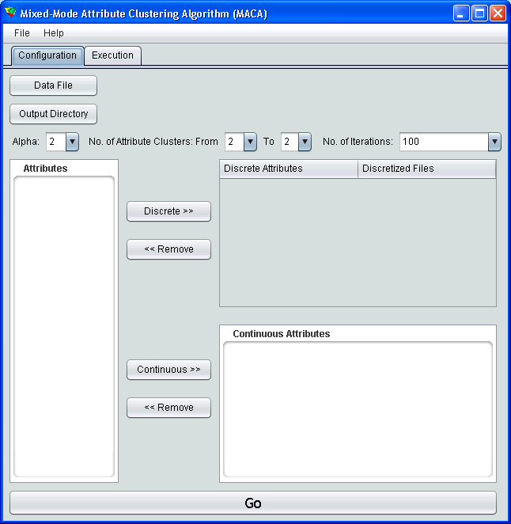

Slide 3
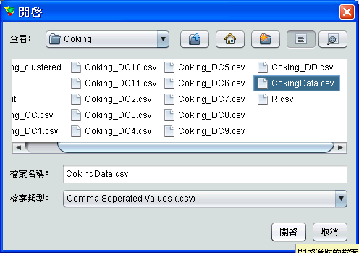

Slide 4
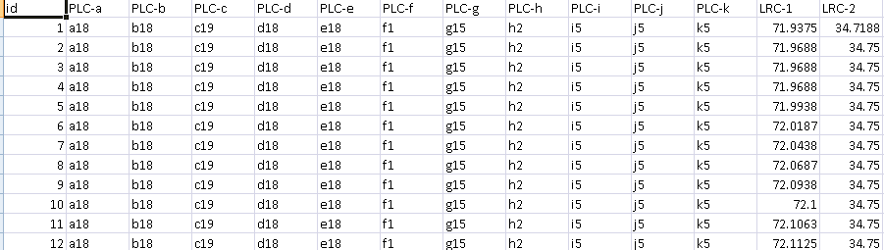
Attribute Type
Open the data file to read the data type
The current version does not distinguish between Discrete and Continuous data automatically

Slide 5
1) Discrete Data Only
Next Experiment

Slide 6
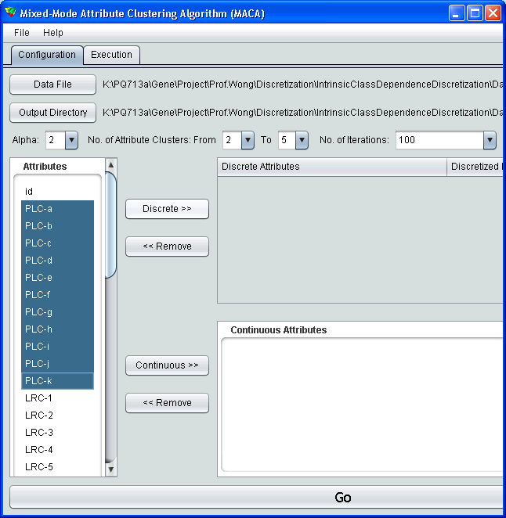
Select discrete attributes from left hand side and press “Discrete >>” button

Slide 7
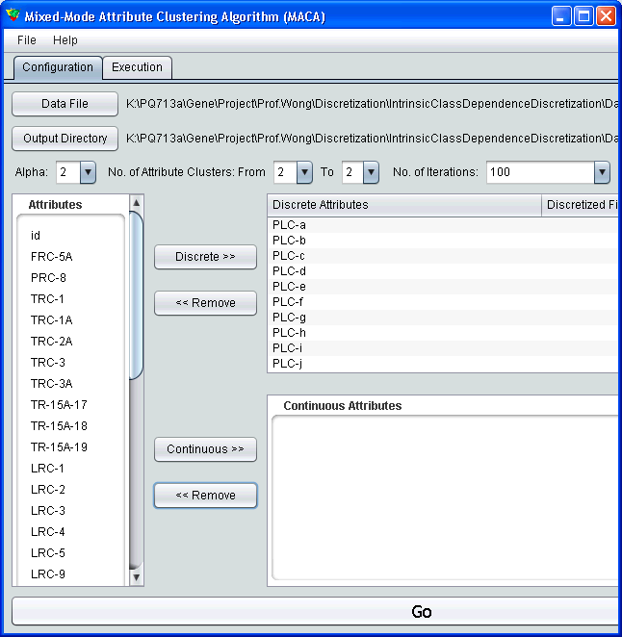
Press “Go” to start the computation and analysis.

Slide 8
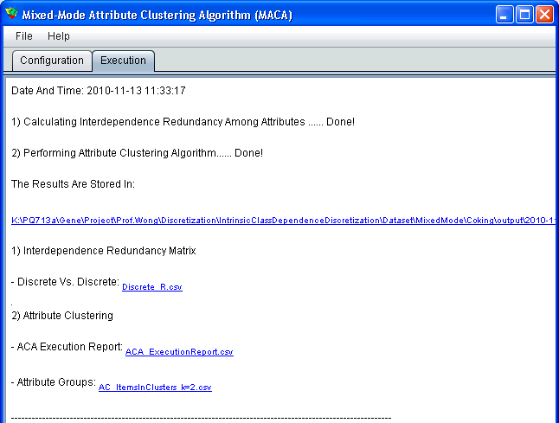

Slide 9
2) Continuous Data Only
Next experiment

Slide 10
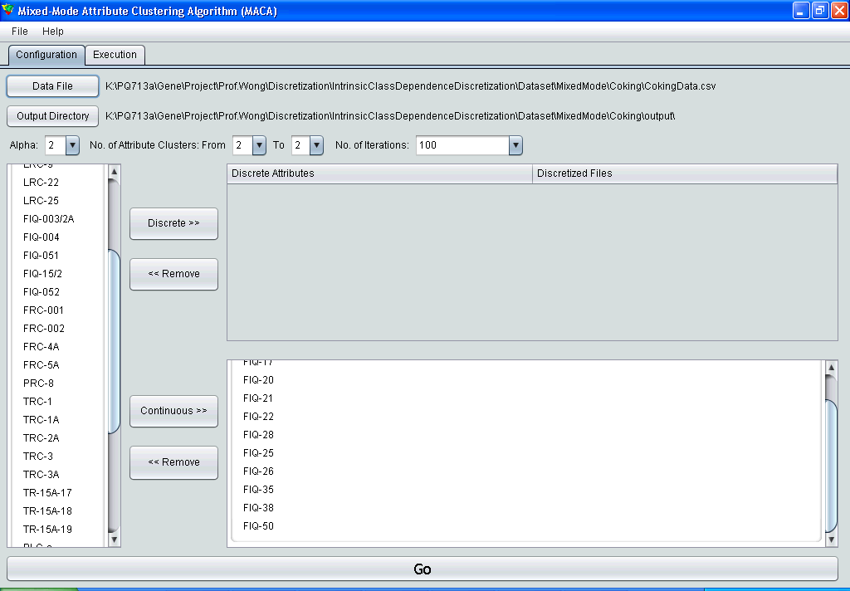
Select continuous attributes from left hand side and press “Continuous >>” button

Slide 11
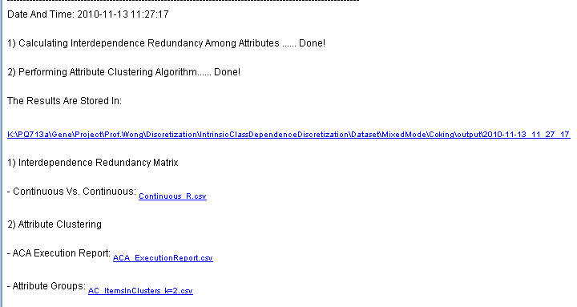

Slide 12
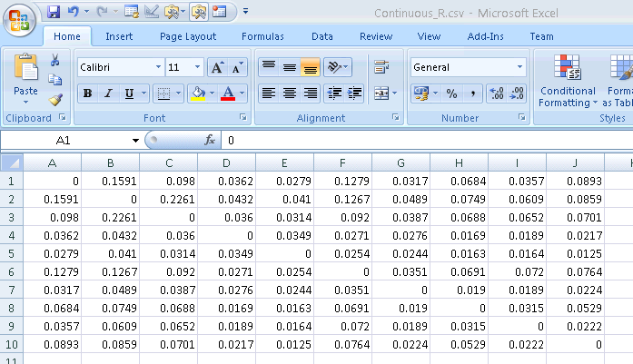
Interdependent Redundancy (R) Matrix

Slide 13
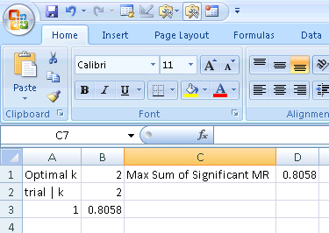
ACA Execution Report

Slide 14
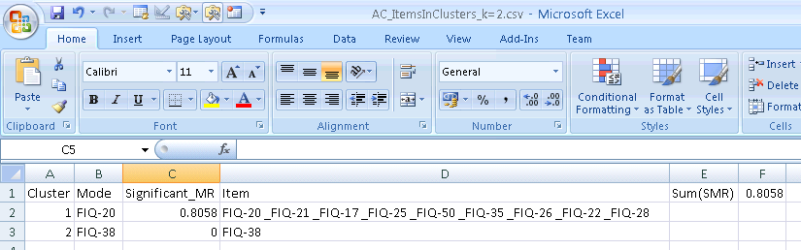
Attribute Groups
Each group contains a Mode, the most representative attribute, and items in each group are separated by “_” in the following format.

Slide 15
3) Mixed Mode Data Case
Need to use OCDD to discretize all continuous attribute by each discretize data
If the data set contains m discrete attributes and n continuous attributes, the n continuous attributes needs to be discretized by OCDD m times.
After this procedure, there will be m sets of discretized continuous attributes.

Slide 16
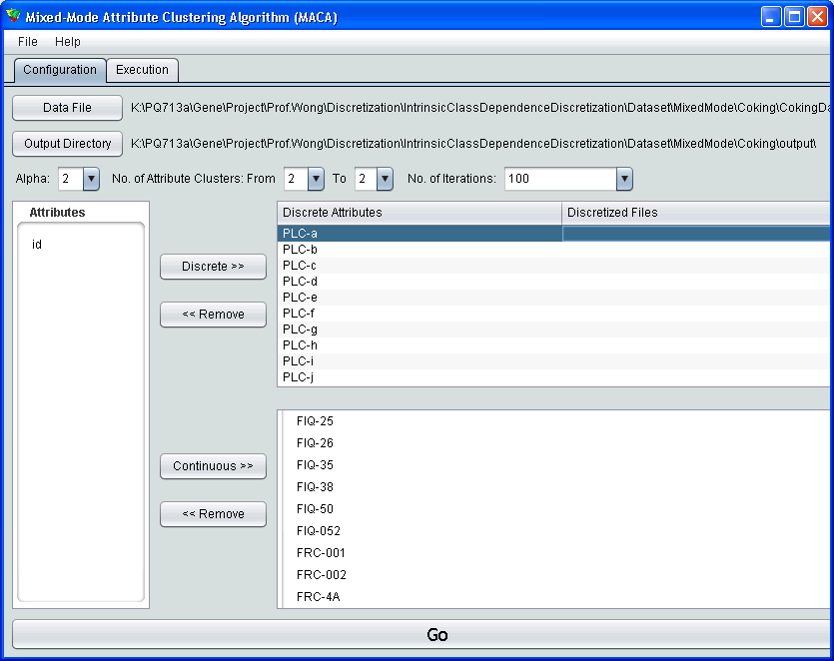
Right Click here to attach the set of continuous attributes discretized by “PLC-a”

Slide 17
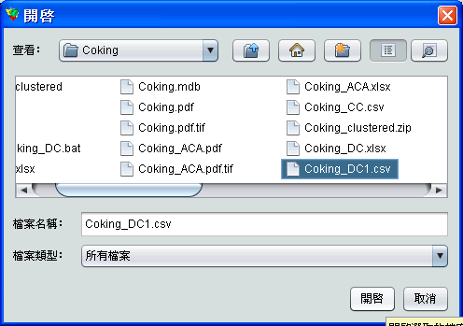
Select the Discretized Continuous Attributes Dataset

Slide 18
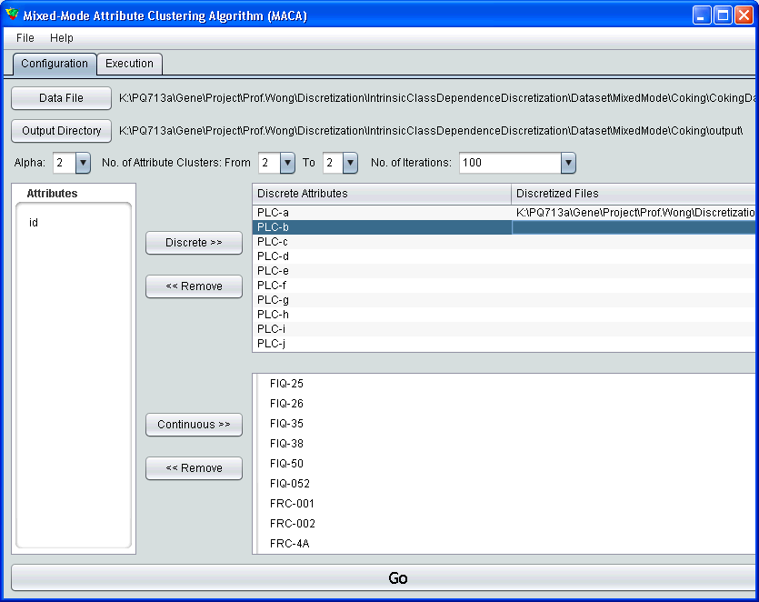
Repeat until all sets of discretized continuous attributes are attached.

Slide 19
Again and again until all discretized continuous files are loaded
Then press “Go”

